Slide 1


(aw)

Slide 2
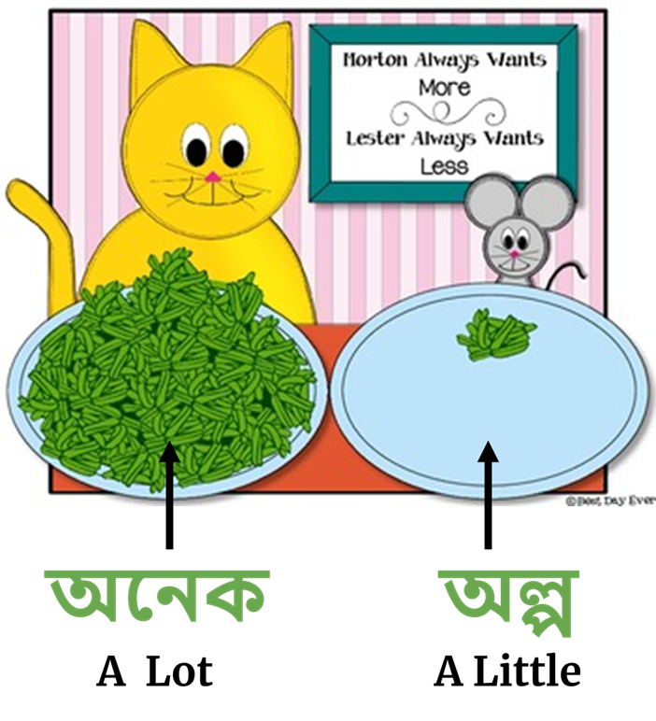
(awnek)
(awlpo)

Slide 3

(a/aa)

Slide 4
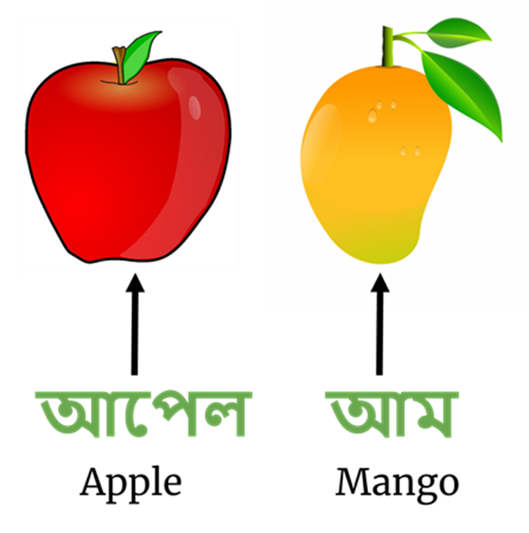
(aapel)
(aam)

Slide 5

(hroshwo-i)

Slide 6
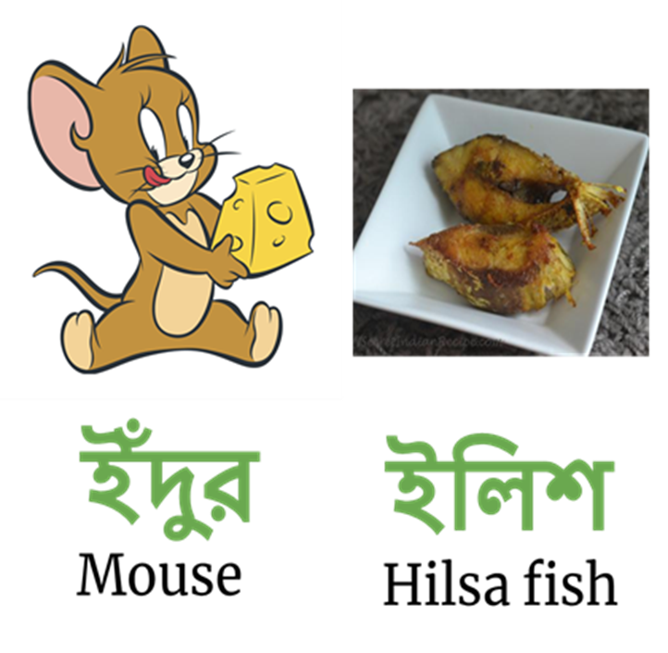
(indur)
(iliSh)
“ই” Sounds like
short “i” in “bin”

Slide 7

(deergho-ee)

Slide 8
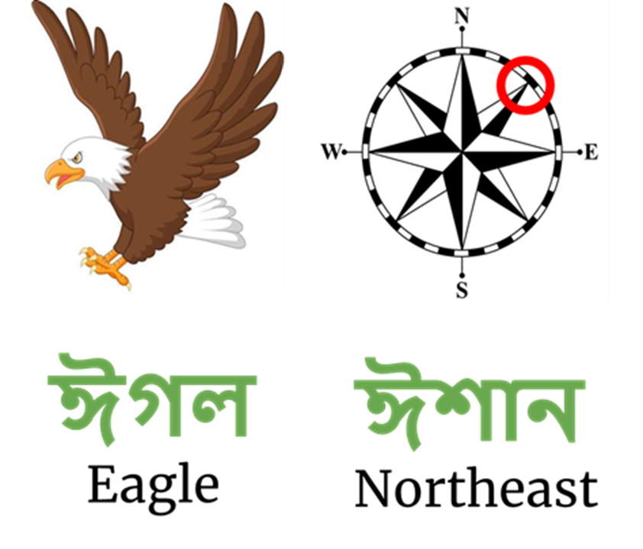
(eegawl)
(eeShan)
“ঈ” Sounds like
long “ee” in “deep”

Slide 9
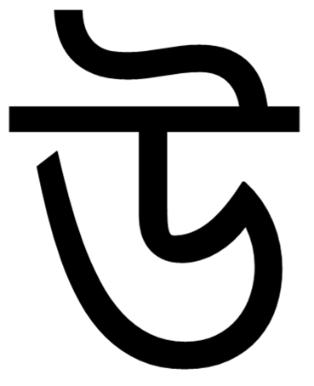
(hroshwo-u)

Slide 10
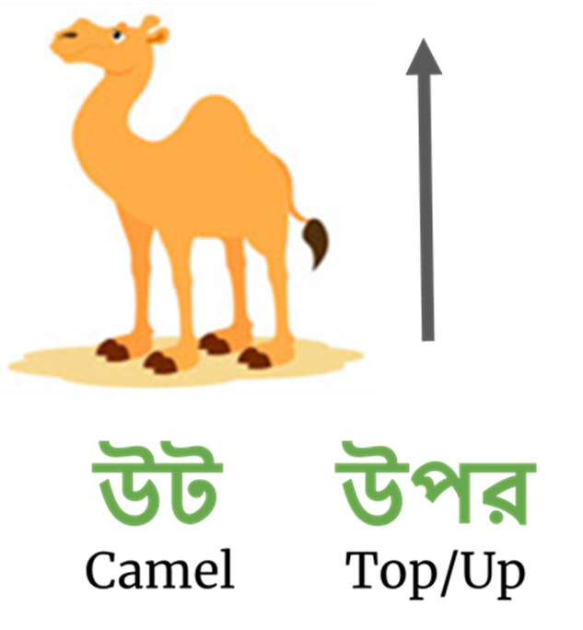
(uT)
(upor)
“উ” Sounds like
short “u” in “put”

Slide 11

(deergho-oo)

Slide 12

(ooSHa)
“ঊ” Sounds like
long “oo” in “zoom”

Slide 13

(Ri)

Slide 14


Slide 15

(Li)

Slide 16
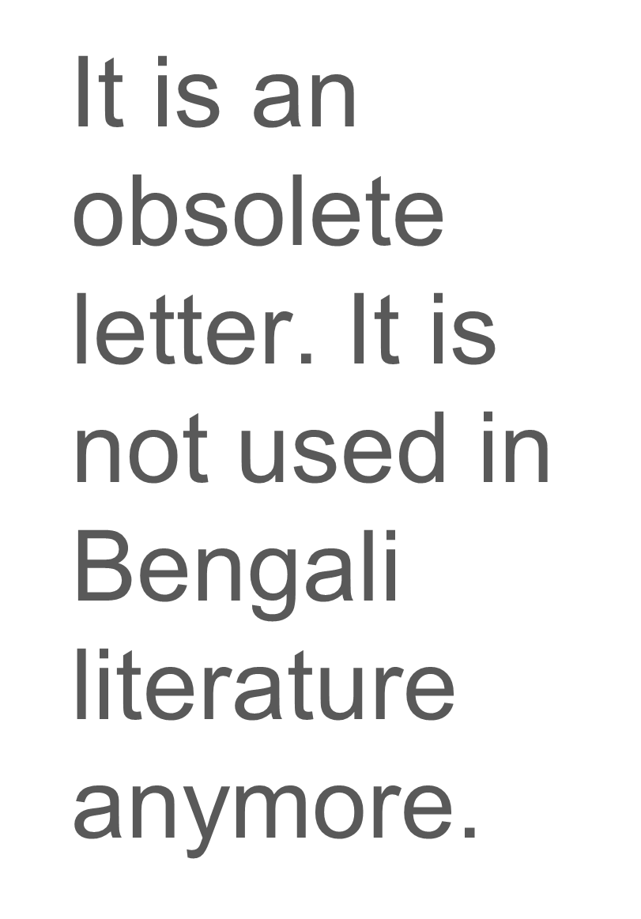

Slide 17

(e/A)

Slide 18
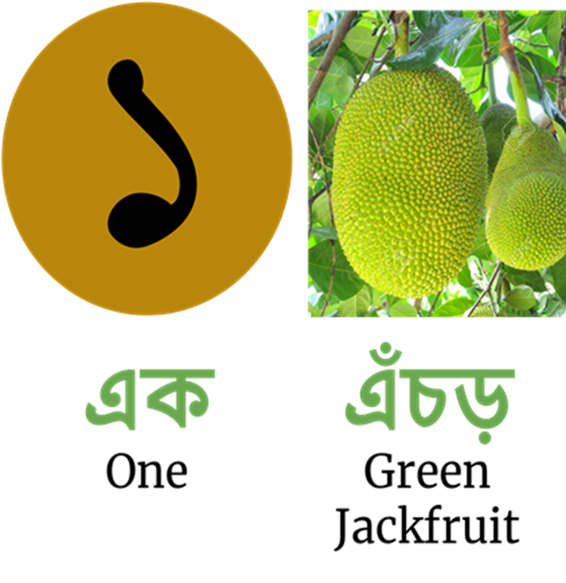
(Ak)
(enchoR)
“এ” Sounds like
“A” in “bat”
or
“e” in “pet”

Slide 19

(oi)

Slide 20

(oidik)
ঐদিক
That way

Slide 21

(o)

Slide 22


(ojon)

Slide 23

ou

Slide 24


(oushawdh)

